Slide 1
DECENTRALIZED INVESTMENT BANKING
The Case of Discount Dividend-Reinvestment
and Stock-Purchase Plans
By
Myron S. SCHOLES & Mark A. WOLFSON
Xunwei (Robin) Liu
9.14.2017

Slide 2
Background information of the authors
Scholes’ colleague at Stanford
Both have interests in the economics of investment banking and tax planning in corporate finance
SCHOLES
WOLFSON
After finished his work with Fama, Miller and Black at U of Chicago, Scholes joined Stanford in 1981, where he and Wolfson became the colleagues
Both Scholes and Wolfson went to the financial markets in the 90s. Scholes went to Saloman Brothers in 1990, and Wolfson co-founded a financial consulting company in 1995. As this paper was published in the 1989, so an interesting guess can be this paper somehow inspired them to go to the industry

Slide 3
Go through the summary
#1
Discount dividend-reinvestment and stock-purchase plans
allow shareholders to capture part of the underwriting fees incurred in new stock offerings
and save sponsoring firms some of the usual underwriting costs.
So that is why the title is called “decentralized IB”, as part of the role of IB in financial market is somehow displaced by this invention of firm
#2
We tested the degree to which individual investors can profitably serve this investment banking function by implementing simple investment/trading strategies designed to capture the discounts and distribute the shares in the market.
This is pretty much what they did in this paper, personally I feel like this is more like an operation summary of their investment/trading strategies
#3
The large profits earned by our strategies raise serious questions about
why it takes firms so long to raise the target level of capital
and why many eligible shareholders do not participate in these discount plans.

Slide 4
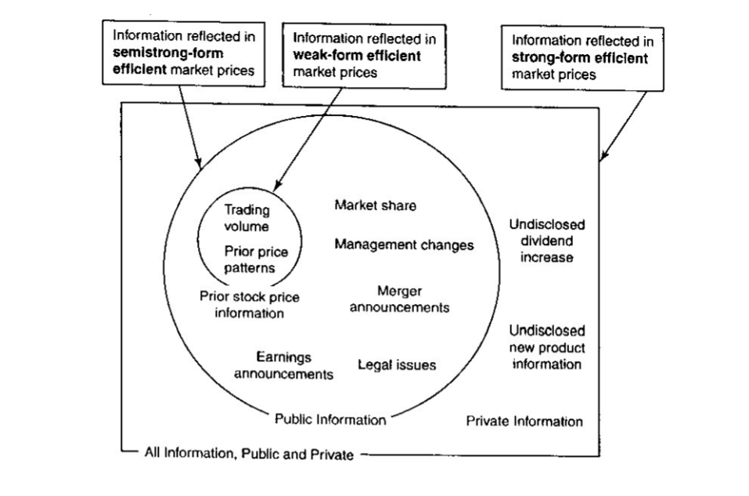
Introduction section

Slide 5
They introduce their motivation to do this research, according to the EMH. Investors cannot profit from publicly available information. But certain anomalies, like “January Effect” and “Monday Effect”, weaken the case of efficient market
Here's one from yesterday. We bid on this particular issue - this happens to be Citizens Insurance, which is a creature of the state of Florida. It was set up to take care of hurricane insurance, and it's backed by premium taxes, and if they have a big hurricane and the fund becomes inadequate, they raise the premium taxes. There's nothing wrong with the credit. So we bid on three different Citizens securities that day. We got one bid at an 11.33% interest rate. One that we didn't buy went for 9.87%, and one went for 6.0%. It's the same bond, the same time, the same dealer. And a big issue. This is not some little anomaly, as they like to say in academic circles every time they find something that disagrees with their theory.
Warren Buffet, 2008
“I often wonder why the whole world is so prone to generalize. Generalizations are seldom if ever true and are usually utterly inaccurate.”
Agatha Christie
But none of the papers, which weaken EMH, test whether investors can actually profit, so in this paper, Scholes and Wolfson documents their investing progress to show why the market is somehow inefficient. They raise further observations after they finish the work, like the comparison between the discount stock-purchase plans and conventional underwritings

Slide 6
What is a discount stock purchase plan?
Feather:
We discovered that many companies offered stockholders the fight to buy additional shares at a discount, typically of 5.263% (or 5/95) from extant market prices.
Steps:
To qualify to buy this discount stock, one had only to hold at least one share of company stock in certificate form and sign up to participate in the discount stock-purchase program.
The next step was to mail in a check for stock periodically. The company then issued, free of commissions, discount shares that could be sold in the market within a few weeks.
Example:
For example, a J.P. Morgan shareholder could buy up to $5,000 of I.P. Morgan stock each month at a 5.263% discount. If the shareholder could immediately sell this stock at no cost, a sure profit of $263.16 would result on each transaction.
5.263%*5000 = 263.16

Slide 7
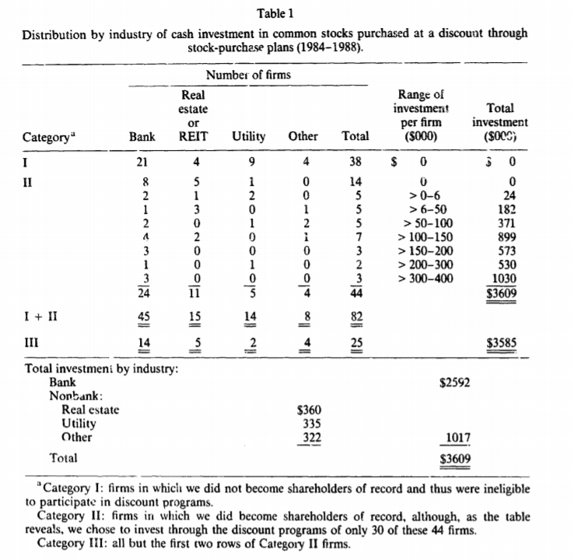
Identified 82 companies
Between the time period of 1984 and 1988
Table one: Industry Concentration
By numbers of project: mainly in banking, real estate, and public utilities.
By amount of the investments: 2.6m out of 3.6m in banks

Slide 8
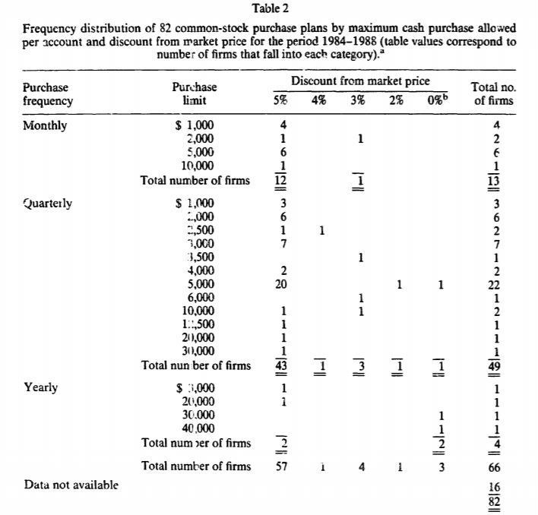
Table two: Investment ceiling and discounts
All firms limit allowable investment – prevent extreme secondary trading
Mostly require that participants possess the certification under their own names – prevent brokers to build large scale

Slide 9
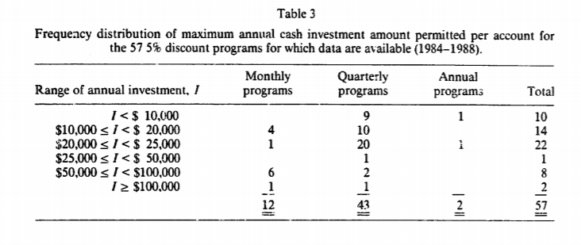
Table three: frequency distribution
Connect with the table 2

Slide 10
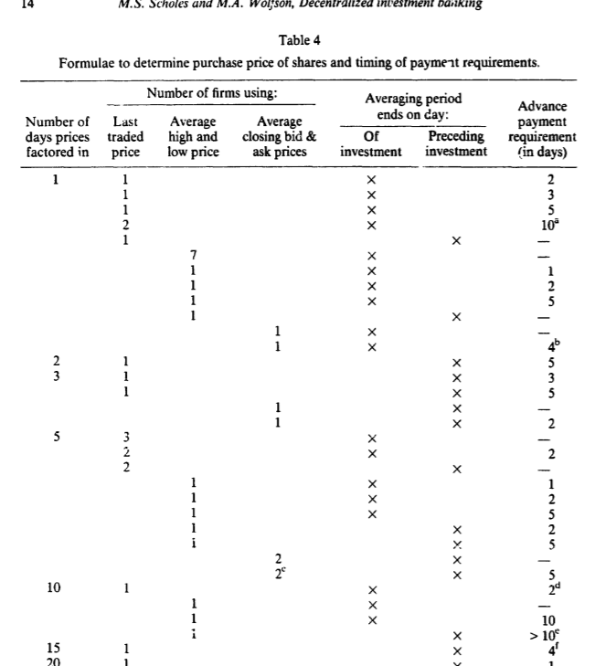
Calculating the actual discount received
4 criteria:
(1) Average of market prices observed over anywhere from one to twenty trading days
(2) Which prices are used: last traded price, daily high and low, closing bid and ask
(3) Averaging period
(4) Advance payment requirement

Slide 11
Cost concern
Cost concern:
To determine if 5% discount is a good opportunity to capture, we need to think of cost, which include the costs of becoming informed about the plan's details, the cost of bearing or avoiding undesired market risks, the cost of monitoring the investment, the transaction costs incurred in the secondary market, and the cost of complying with margin requirements and tax laws
One example: if share price declines during the averaging period, part of or all of the discount could disappear
To illustrate, suppose the purchase price for shares is 95% of the average closing price over the five days ending just prior to the investment date. If these prices are $25.00, $24.50, $25.00, $23.75, and $23.00, the average is $24.25, and the purchase price becomes 95% of this average, or $23.0375. The 'discounted' purchase price of the shares actually exceeds the last traded price of $23.00, and the effective discount becomes a negative 0.16%

Slide 12
Several refinements
Refinements:
Batch processing, eight in total, two adults plus two children each household
Insurance:
Put option on assets take long positions – effective but expensive
Sell short – effective but expensive as well, required to pledge cash or securities as collateral
Macro hedge, purchase put options on a market index
More investment accounts:
Scale effect is important, as the cost if relatively fixed (searching and learning process)
Brokerage fee can be relatively cheaper, as the broker agrees to sell all the shares in different accounts in a single trade through the single brokerage account
Some companies encourage multiple accounts, some don’t, so Scholes and Wolfson need to find out whether multiple accounts could be used
Securing lines of credit:
To solve the budget constraint, arrange for lines of credit totaling $300,000, the borrowing never exceeded 50% of their total investment because of margin rules

Slide 13
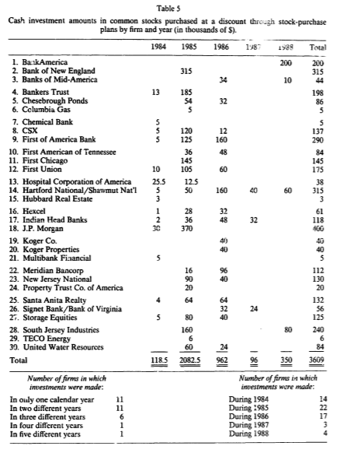
Changes in the level of investment activity over time
Out total initial investment over the five-year period for any given firm ranged from a low of $3,000 to a high of $400,000. For any given year, initial investment in individual firms ranged from a low of $1,000 to a high of $370,000.
The $370,000 was invested in J.P. Morgan in 1985. Morgan’s discount was terminated in October 1985. The $370~000 investment was the result of investing $5,000 per month in eight accounts for eight months plus $5,000 in ten accounts for one month.
A total of $315,000 was invested in Bank of New England, also in 1985. Like J.P. Morgan the bank terminated its discount late in 1985.

Slide 14
Policies changes do matter
Scholes and Wolfson took a break in 1987, primarily due to:
First, a regulatory change applying to brokers precluded our trades from being merged into a single transaction after December 31, 1986. This increased our proportional brokerage fee dramatically. For the trades undertaken in 1988, our brokerage fee still averaged well under one-half of 1%, but if we had undertaken the same trades in 1985 and 1986 under the post-December 31, 1986 rules, our commissions would have been three to four times as large as the 0.2270 rate we incurred in those years (for an additional cost of $15,000-$20,000).
The second factor relates to family tax planning. Before the effective date of the Tax Reform Act of 1986, the dividends and capital gains earned in our children's names were taxable at bargain rates. As of January 1, 1987, this was no longer true tor two children.

Slide 15
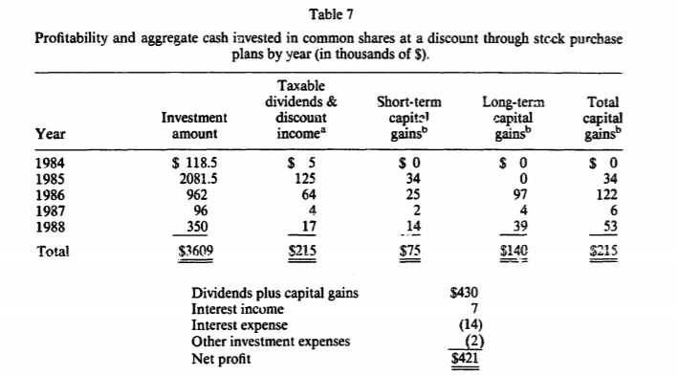
Opportunity cost?
$430,000 of gross income in total
Minus net interest expense of $7,000
Minus $2,000 of other expenses
Leaving $421,000 in net profits
What if Scholes and Wolfson had invested alternatively?
To estimate whether our investment in discount programs underperformed a naive investment strategy, we assumed that our investment alternative would have simply been to invest in the Salomon Brothers bank stock index. These calculations are shown in panel B of table 8

Slide 16
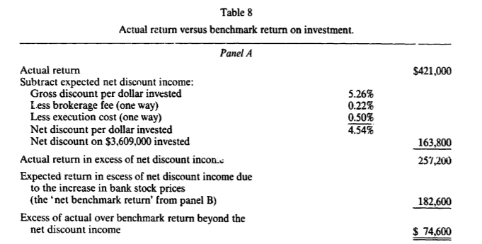
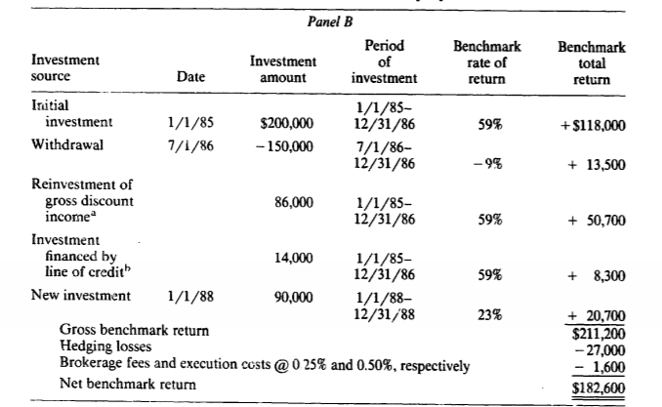
163,800 = 3,609,000*5.26% - the costs to sell shares (brokerage fees and execution costs) = 3,609,000*4.54%
$74,600 above the benchmark, the excess return is 12% per year
So the concern that discount income would, in part, disappear because of poor stock performance for the sponsoring firms was not borne out by our experience (still positive). The favorable stock performance for firms offering discount stock-purchase plans is somewhat surprising and is worthy of further investigation. (they are not delivering a message that stock issuance suggests the stock price is overvalued)

Slide 17
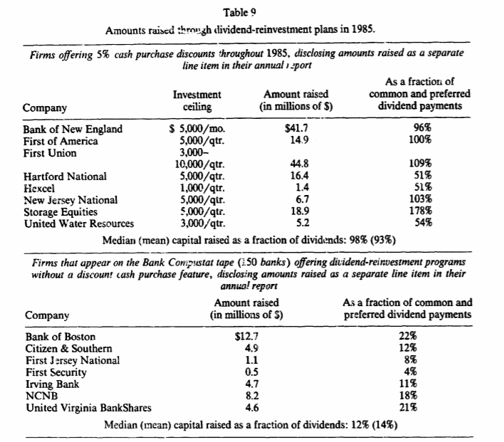
How much money is raised
Table 9 reports capital amounts raised through dividend-reinvestment plans in 1985 for two categories of firms. In the first category are eight firms offering 5% discounts on optional cash purchases of shares throughout the entire
calendar year (1985) and that reported the amounts raised as a separate line item in their annual reports. The seven firms in the second group make similar financial statement disclosures but offer no discounts on cash purchases.
The eight firms offering 5% discounts raised through their programs an average of 98% (median; the mean is 93%) of the common and preferred dividends they paid in 1985. By contrast, the seven firms offering no discounts raised an average of 12% (median; the mean is 147o) of their common and preferred dividends.

Slide 18
Sensitive to minor changes
United Water Resources and Hexcel offer less generous investment opportunities than the other six firms offering 5% discounts. Although the table does not show it, these firms' common stocks are also less actively traded than the
stocks of the other firms, making execution costs higher. Accordingly, the capital raised for these firms, as a fraction of common and preferred dividends, is just above 50%, or less than half as much raised by the other firms offering 5% discounts.
The other firm that stands out is Hartford National. Although this is a large firm that offered generous investment limits and whose shares traded actively, the program raised only 51% of common and preferred dividends in 1985. The only clue we have to explain this discrepancy is that Hartford National was notably slower in 1985 than were other firms in sending us certificates for shares we bought through the discount program. If our experience is typical, this slowness discouraged shareholder investment.
Over the nine months of 1985 in which J.P. Morgan offered a discount program, it raised $92 million through its dividend-reinvestment plan (or 44% of common and preferred dividends paid for the entire year). In 1986, in the
absence of a discount cash purchase option, $55 million was raised through the reinvestment plan (only 23% of common and preferred dividends).
The decline in capital raised through Bank of New England's dividend reinvestment plan was even more dramatic. In 1986, in the absence of a discount, only $8.3 million was raised (down from $41.7 million in 1985). This is only 15% of common and preferred dividends (down from 96% in 1985).

Slide 19
Motivation in sponsoring discount stock-purchase programs
(1) Raising capital – using discount as an incentive
(2) Some are interested in promoting long-term investment by shareholders.
(3) Others appear interested in encouraging wider ownership of shares, perhaps to make a change in corporate control more difficult to effect.
(4) And with the possible exception of BankAmerica and a couple of other large banks, all firms seem to be concerned about the effect on share prices of arbitrage by plan participants.
An extreme case – BankAmerica
In June 1987. The plan permitted shareholders of record to invest up to $10,000 per month in common shares at a 5% discount from market prices. The plan was so popular that BankAmerica decided to reduce the discount to 4% a mere four months later.
In June 1988, the discount was reduced further to 3% and the bank announced that participants could request permission to invest more than $10,000 per month. We inquired by phone whether an investment of $100,000
in the forthcoming month would be allowed. The answer was yes, but the plan administrators would not reveal what the investment ceiling might be.
To more further cuts in September 1988 and February 1989, to 2.5% and 2%, respectively, still raised great amount of money
The BankAmerica program raises an interesting tradeoff between equity and efficiency considerations. While a relatively few well-endowed shareholders are likely to dominate the plan, they are also likely to be the most efficient 'underwriters' of the firm's securities, and at a 2% discount, the total underwriting fee paid is 60% less than that incurred in the 5% discount program.

Slide 20
Corporate finance implications of DRP
Under this section, Scholes and Wolfson briefly talk about the announcement effects of underwritten stock and stock-rights issues by other scholars
We learned from our conversations with the sponsors of discount stock purchase plans that the negative response to an announced equity offering is an important consideration in decisions to raise equity through a stock purchase
plan. It has been noted that the stock-price decline may be attributable to investor concern that equity is being issued because management has private information suggesting that the stock is overpriced [see, for example, Myers and Majluf (1984)].
But if management wants to raise equity capital and does not have negative inside information, committing the firm to raise money to finance a future project over a period of months or years, rather than all at once, may mitigate the adverse selection problem. Raising capital over time allows some of the information management has when the plan to raise equity is announced to be reflected in publicly disclosed accounting measures of performance and other outlets, thereby reducing information asymmetries.

Slide 21
The practice that firms limit the amount of stock investors may purchase at a discount slows down the rate at which funds are raised, which may enable the firm to issue equity without incurring the loss in the market value that typically accompanies conventional underwritten equity issues. So discount stock-purchase plans can be viewed as a form of 'sunshine trading’, this increases the transparency and decreases the issue of asymmetry information
Smith (1986) has argued that the more severe the information asymmetry between managers and outside securityholders the greater the demand for the monitoring and certification services of an investment banker. The discount of 5.26% offered to shareholders in discount stock-purchase plans is similar to the direct costs incurred in using the services of an underwriter. But the discount stock-purchase plan allows some of the discounts to be earned by current shareholders, and these plans appear to avoid a negative impact on stock prices.

Slide 22
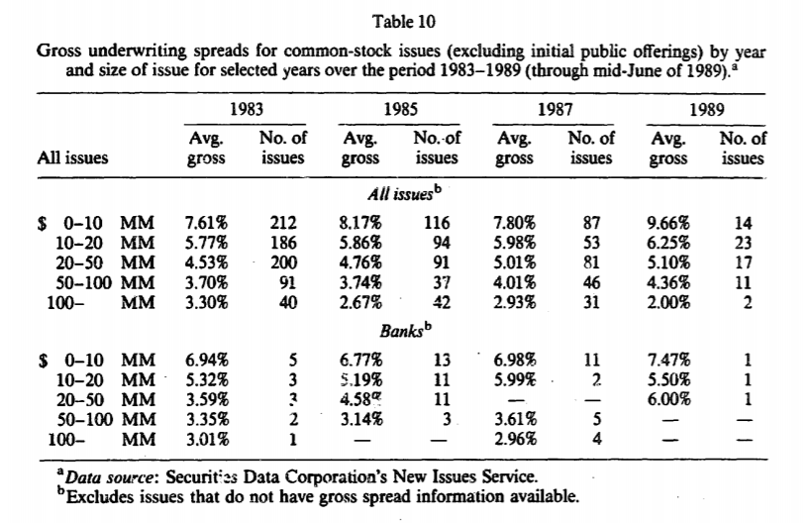
The advantage of discount programs
Table 10 shows the underwriting costs by size of offer and year of offering for the post-shelf registration years 1983, 1985, 1987, and 1989 (through mid-June of 1989), for all common-stock issues and bank common-stock issues, In the $20-$50 million range for share issues, the fees (excluding direct issue costs) are 4.5% to 5.0% of issue size. Fees for shares issued by banks are somewhat smaller, typically 3.5% to 4%.
So while discount stock-purchase programs are not directly comparable to underwritten offerings as a mechanism for raising new capital, the direct cost of the two mechanisms appear to be similar, and discount programs both appear to avoid market impact costs and allow some of the underwriting fees to be earned by existing shareholders.

Slide 23
Concluding remarks
The experiment allowed us not only to test whether we could earn abnormal profits based on publicly available information (test the EMH), but also let us to consider why firms would use discount stock-purchase programs with restrictions on investor participation. At a discount rate of 5%, the programs in which we participated offered substantial profit opportunity, especially to investors choosing to exploit the available natural economies of both scale (for a given plan) and scope (across plans). Since most shareholders do not participate in these plans (and therefore do not share in the discounts) the question arises whether a 5% discount is too generous to maximize the welfare of current shareholders. The elimination of discounts on optional cash purchases in so many plans (particularly in 1986) is consistent with this speculation.
Another explanation for termination of cash discounts is simply that firms raised the target level of capital. Given the profits we (and presumably others) made, firms might have been able to raise the same amount of capital at less direct cost to shareholders by reducing the size of the discount and increasing investment limits, as BankAmeriea and a few others have done.
Interest conflict between investment banks and those discount stock purchase programs, as the investment banks lose underwriting fees if these programs displace conventional underwritings

Slide 24
Personal comments
When googling discounted stock purchase plan, the results comes out to be “employee stock purchase plan” (ESPP), so not that much popular anymore, the limitation of the paper (1989)
Like an executive summary of their investing operation, instead of being a traditional academic paper. For me it is a fresh experience to read such a paper. And this is also an interesting challenge to EMH
How to resolve the issue of asymmetric information
Give more time to let the information spread so that the market can react
Warranty? In our financial intermediation class
Understanding the policy is important, especially regarding to the tax
So Trump’s reformation in tax would be interesting to study
New challenge to the role of investment banks in the modern time?

